Slide 1
ERAU ASCEND! OverView
Adam Ritchie
Nicholas Hammons
Andrew Grant
Geimi Delarge

Slide 2
Overview
Flight Objectives
Payload
Flights Taken
Conclusions
Future Goals

Slide 3
Flight Objectives
Gain better knowledge of the nature of composite materials
Gather temperature data along the flight
Gather IMU data
Gather pressure data along the flight
Gather solar cell data along the flight
Track and recover payload

Slide 4
Payload
8 Inch Composite Cube
Bi-directional Carbon with ¼” foam core
E-glass shelving system and lid
Automatic Position Reporting System (APRS)
Lassen IQ GPS
TTY TinyTrak4 TNC
Alinco radio
Logomatic Data Logger

Slide 5
Payload (continued)
First Flight Only
Sparkfun 6 DOF IMU
HOBO Datalogger
Second Flight Only
Invensys Pressure Sensor
Dallas One Wire Thermistors
Two Solar Cells
28-X1 Picaxe Microcontroller

Slide 6
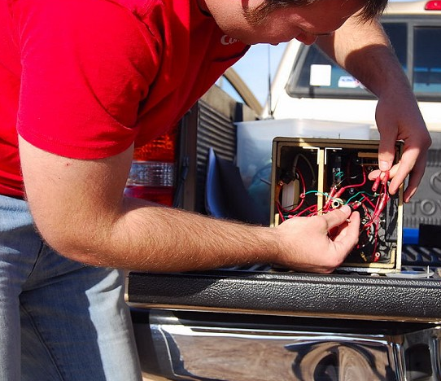
Flight #1: Nov. 22, 2008
Launched from Gila Bend
Traveled 61.1 statute miles
Flight time: 2:02:32
Peak Altitude: 95,867 ft.
Landed south of Chandler
Source: kd7lmo.net

Slide 7
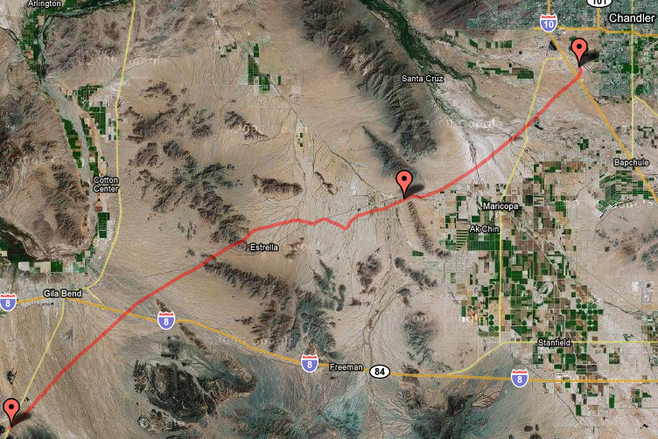
Flight #1 (continued)
HOBO datalogger recorded temperature and relative humidity
IMU data was retrieved but could not be analyzed
GPS tracking was successful up to burst and then during part of the descent
Source: kd7lmo.net

Slide 8
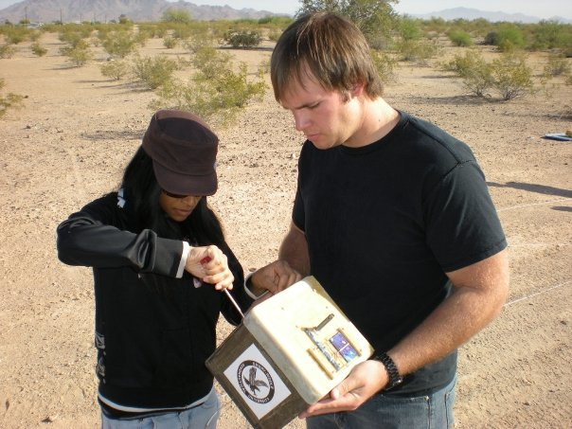
Flight #2: April 4, 2009
Launched from Gila Bend
Traveled 81.4 statute miles
Flight time: 1:57:05
Peak Altitude: 89,676 ft.
Landed East of Florence

Slide 9
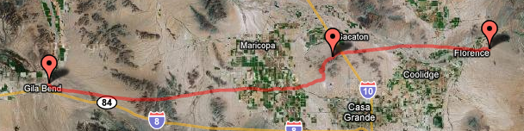
Flight #2 (continued)
Temperature, pressure, and solar cell data successfully recorded
GPS never acquired satellites due to antenna installation
Source: kd7lmo.net

Slide 10
Conclusions
Two successful launches
Recovered payload after both launches
Gathered temperature, pressure, and IMU data
Cannot put aluminum tape over GPS antenna
Created own systems instead of using heavy, off the shelf systems
Improved structural layout to improve wiring layout

Slide 11
Future Goals
Reduce weight
Improve wiring by integrating PCB
Make GPS more reliable
Integrate solar cells to power the payload
Questions?

Slide 12
Thank You!
Dr. Ron Madler
Jack Crabtree
Dr. John Nafziger
Chris Smith
ANSR
Susan Brew

Slide 13
Structures and System Integration
Nicholas Hammons

